Slide 1

Geometry
Unit 1, Lesson 1 Defined and Undefined Terms – Part 1 Volume 1, pg. 3

Slide 2


Benchmarks
MA.912.GR.1.1
Prove relationships and theorems about lines and angles. Solve mathematical and real-world problems involving postulates, relationships, and theorems of lines and angles.
MA.912.GR.2.2
Identify transformations that do or do not preserve distance.
volume 1, pg. 3

Slide 3
Integrated Mathematical Thinking and Reasoning Standards
MA.K12.MTR.1.1 Actively participate in effortful learning both individually and collectively.
MA.K12.MTR.2.1 Demonstrate understanding by representing problems in multiple ways.
MA.K12.MTR.4.1 Engage in discussions that reflect on the mathematical thinking of self and others.
volume 1, pg. 3

Slide 4

Learning Targets
I can use rigid motions to define parallel lines and perpendicular lines.
I can experiment with rigid motions on a plane.
I can use rigid motions to define a right angle.
volume 1, pg. 3

Slide 5

Warm-Up
volume 1, pg. 3

Slide 6

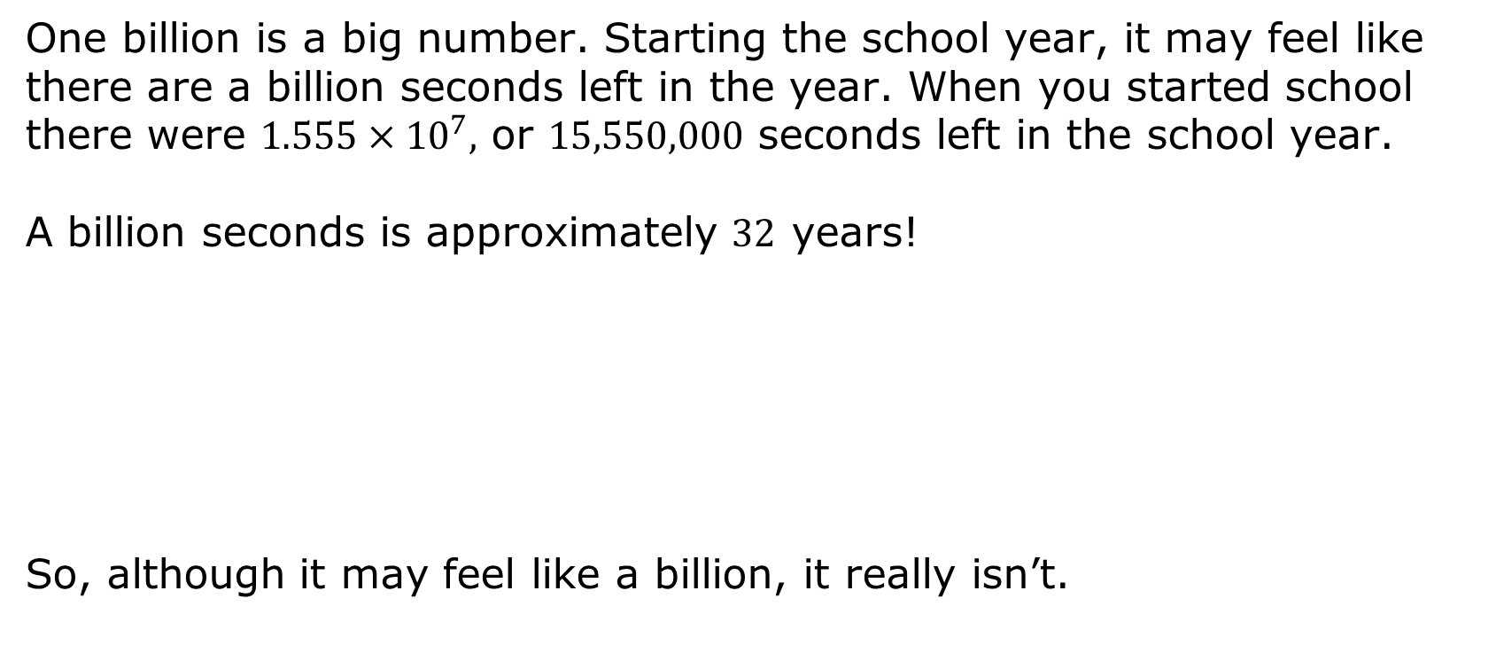
1.1.1 Warm-Up: A Billion!
One billion is a big number. Starting the school year, it may feel like there are a billion seconds left in the year. When you started school there were $1.555×{10}^{7},$ or $15,550,000$ seconds left in the school year.
A billion seconds is approximately $32$ years!
So, although it may feel like a billion, it really isn’t.
volume 1, pg. 3

Slide 7



What is the location of 1 billion on the line segment?
Describe your strategy for estimating the location of $1$ billion on the line segment.
$$0$$
$1$ trillion
volume 1, pg. 3

Slide 8

Guided Instruction
volume 1, pg. 4

Slide 9
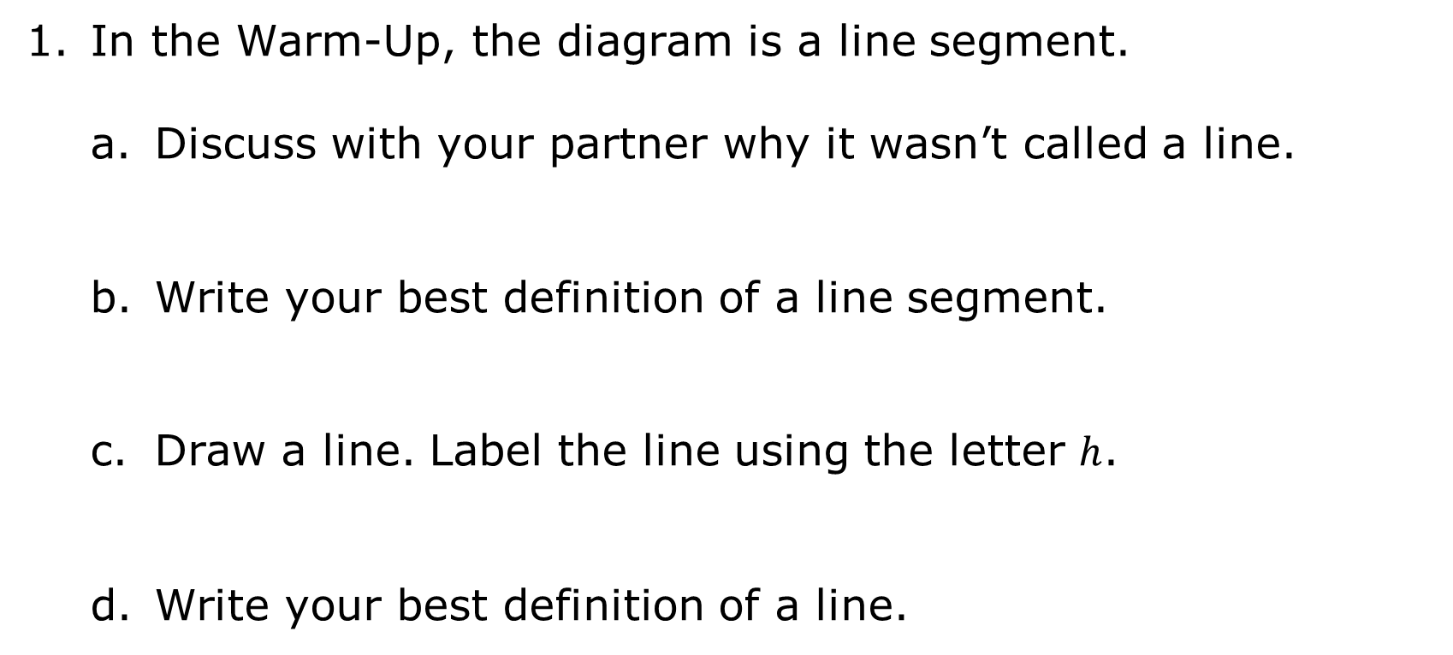
1.1.2 Guided Instruction: Definitions
In the Warm-Up, the diagram is a line segment.
Discuss with your partner why it wasn’t called a line.
Write your best definition of a line segment.
Draw a line. Label the line using the letter $h$.
Write your best definition of a line.
volume 1, pg. 4

Slide 10
Ask another partner pair the definitions they wrote. Record their definition and write your summary of their reason for the definition. You are the only person who should write in the first two columns of the table. Have the person initial next to your summary stating that your summary was correct.
Definition | My Summary of Their Reason | Initials
line segment
line
volume 1, pg. 4

Slide 11

Facts About Lines
A line has infinite length, with no height and no width.
A line is assumed to be straight.
A line is considered one-dimensional.
A line is considered an undefined term.
A line goes on forever in both directions.
A line has infinite length, thus, any line drawn should have arrowheads on both ends.
A line can be named by a single lowercase script letter, or by any two (or more) points which lie on the line.
volume 1, pg. 4

Slide 12
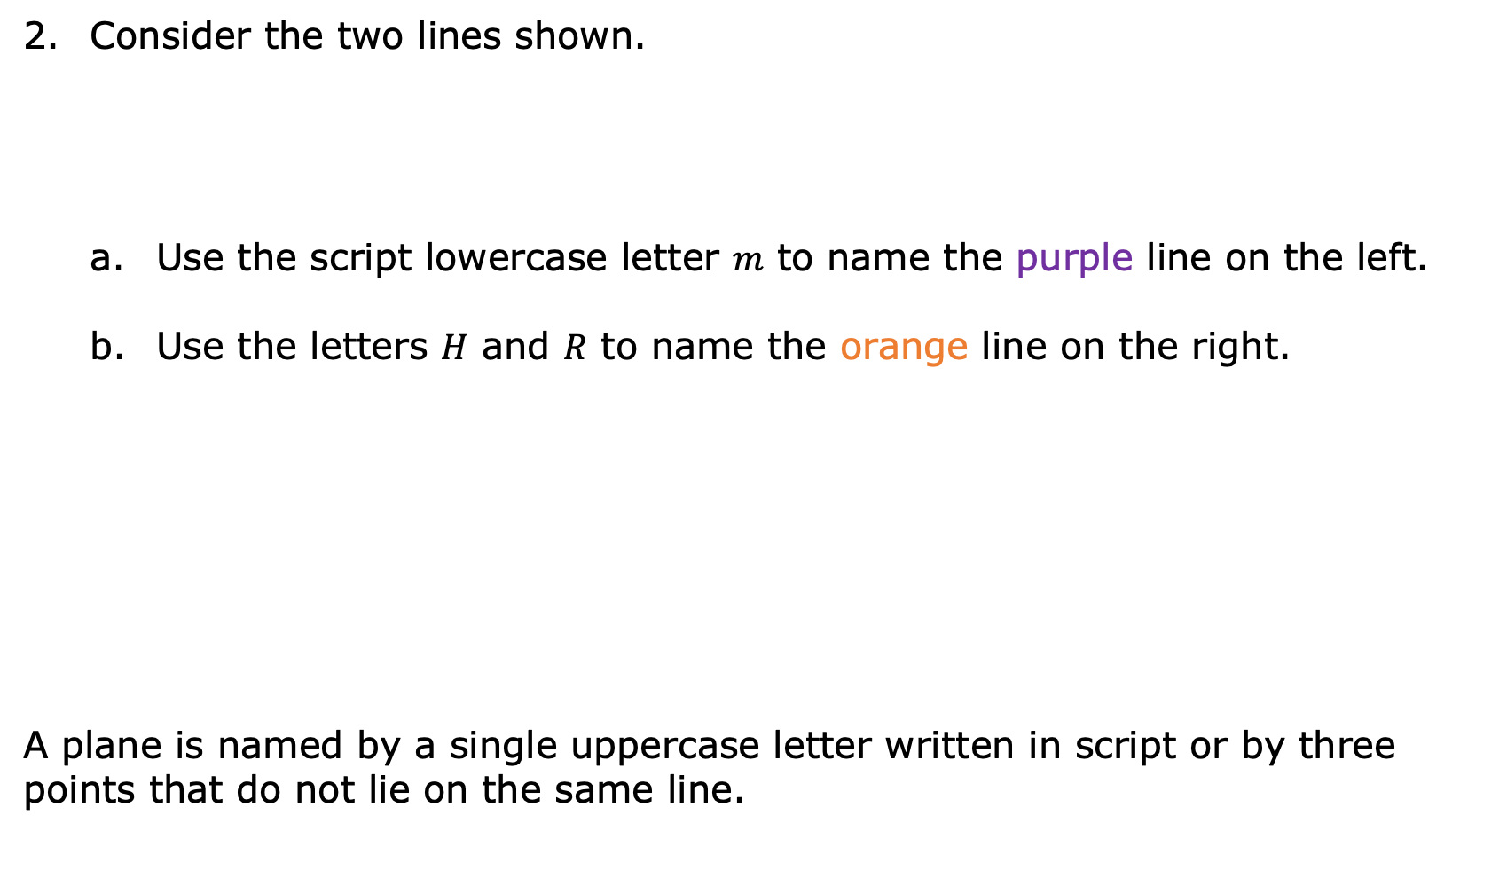
Consider the two lines shown.
Use the script lowercase letter $m$ to name the purple line on the left.
Use the letters $H$ and $R$ to name the orange line on the right.
A plane is named by a single uppercase letter written in script or by three points that do not lie on the same line.
Facts About Planes
A plane has infinite length and width, with no height.
A plane is considered two-dimensional.
A plane is considered an undefined term.
A plane goes on forever.
volume 1, pg. 5

Slide 13
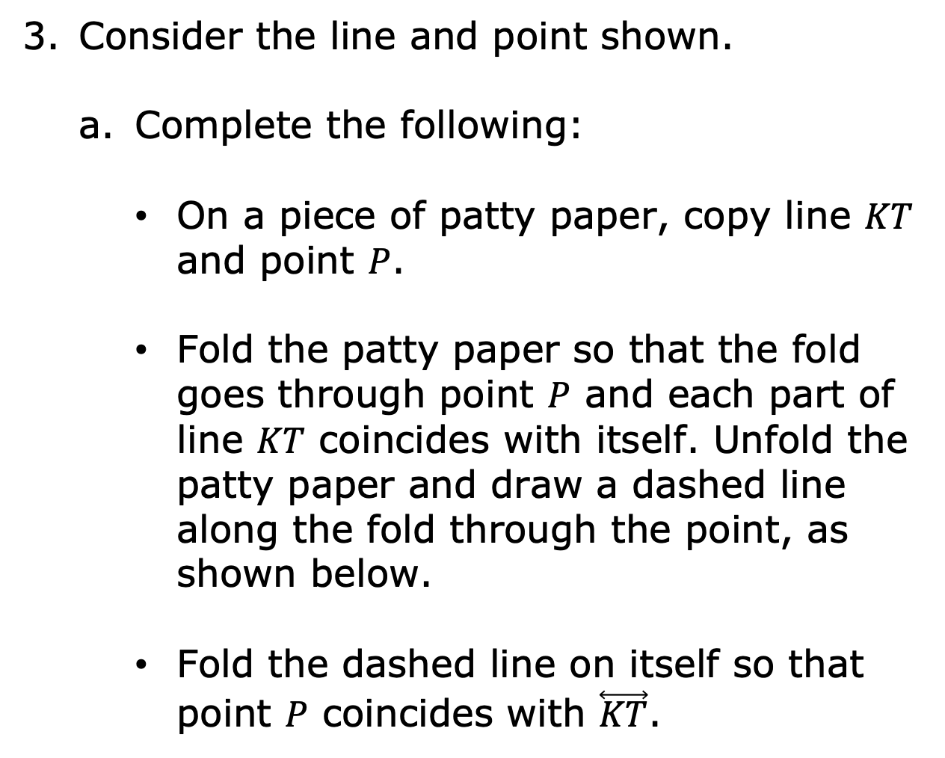
Consider the line and point shown.
Complete the following:
On a piece of patty paper, copy line $KT$ and point $P$.
Fold the patty paper so that the fold goes through point $P$ and each part of line $KT$ coincides with itself. Unfold the patty paper and draw a dashed line along the fold through the point, as shown below.
Fold the dashed line on itself so that point $P$ coincides with $\overset{⃡}{KT}$.
volume 1, pg. 5

Slide 14
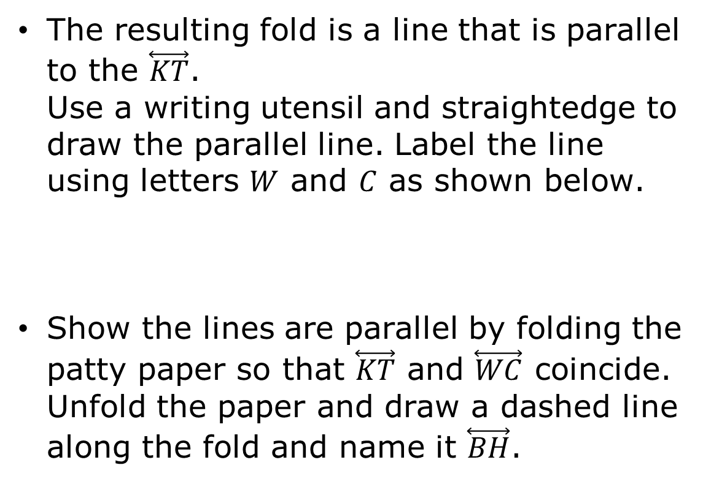
The resulting fold is a line that is parallel to the $\overset{⃡}{KT}$. Use a writing utensil and straightedge to draw the parallel line. Label the line using letters $W$ and $C$ as shown below.
Show the lines are parallel by folding the patty paper so that $\overset{⃡}{KT}$ and $\overset{⃡}{WC}$ coincide. Unfold the paper and draw a dashed line along the fold and name it $\overset{⃡}{BH}$.
volume 1, pg. 6

Slide 15
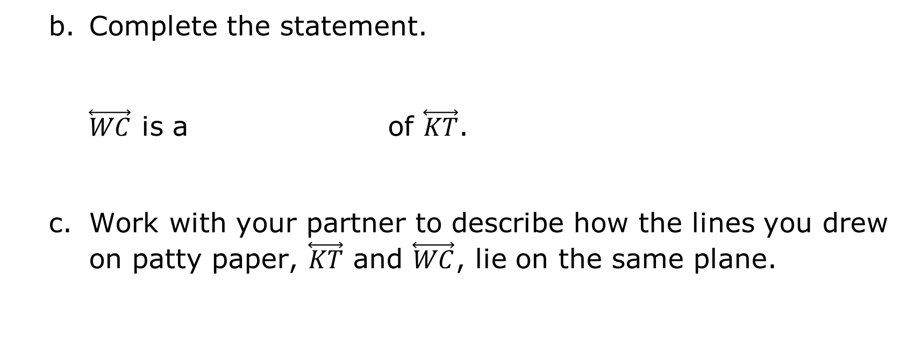
Complete the statement.
$\overset{⃡}{WC}$ is a of $\overset{⃡}{KT}$.
Work with your partner to describe how the lines you drew on patty paper, $\overset{⃡}{KT}$ and $\overset{⃡}{WC}$, lie on the same plane.
rotation
reflection
volume 1, pg. 6

Slide 16

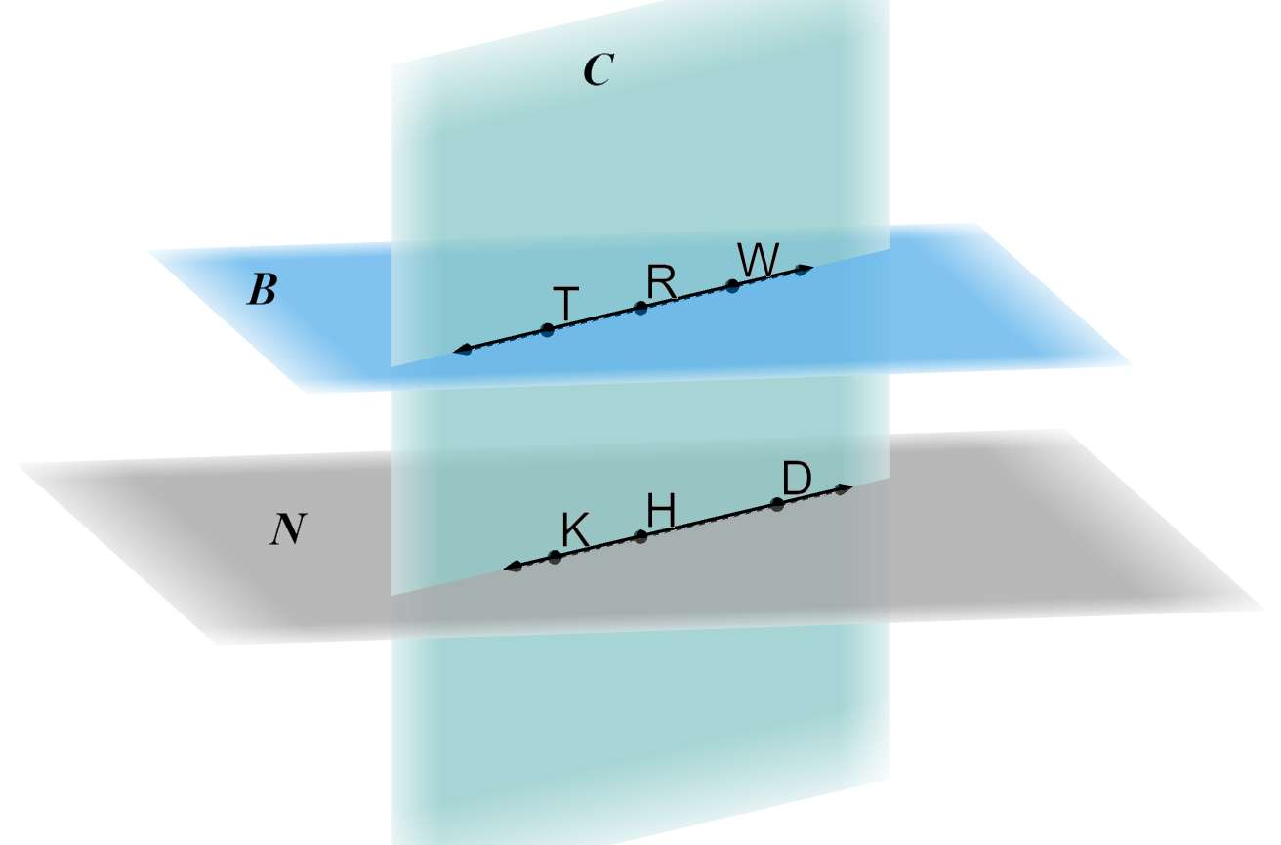
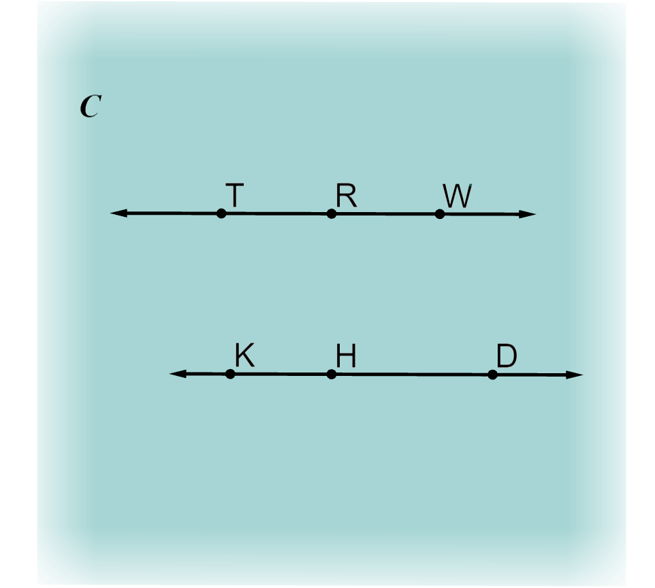
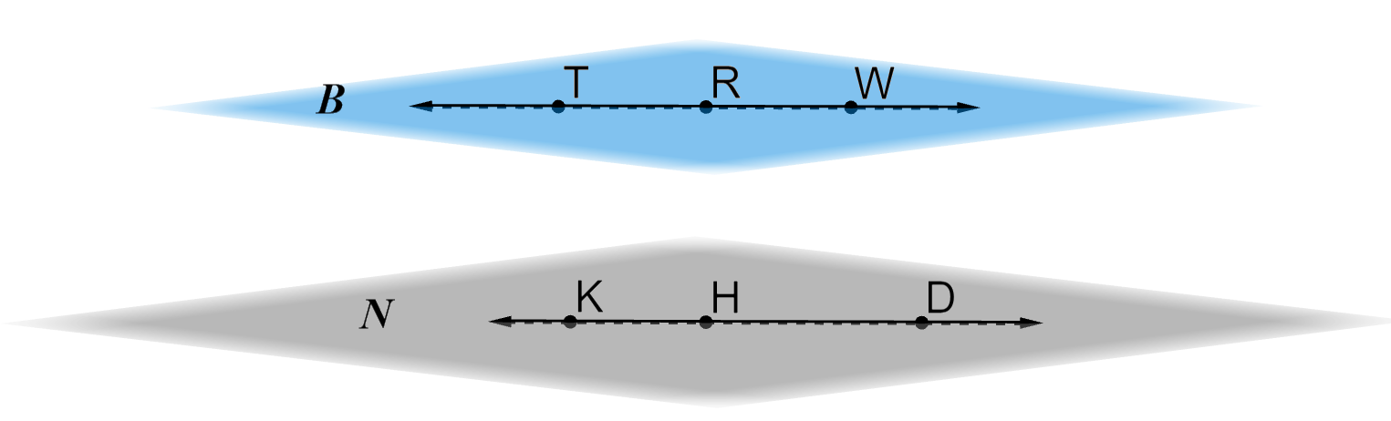
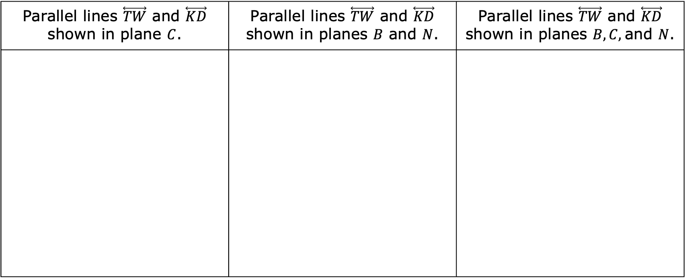
Parallel lines do not intersect and lie in the same plane.
The table shows multiple examples of parallel lines.
Parallel lines $\overset{⃡}{TW}$ and $\overset{⃡}{KD}$ shown in plane $C$. | Parallel lines $\overset{⃡}{TW}$ and $\overset{⃡}{KD}$ shown in planes $B$ and $N$. | Parallel lines $\overset{⃡}{TW}$ and $\overset{⃡}{KD}$ shown in planes $B, C,$and $N$.
volume 1, pg. 6

Slide 17

Collaboration
volume 1, pg. 7

Slide 18



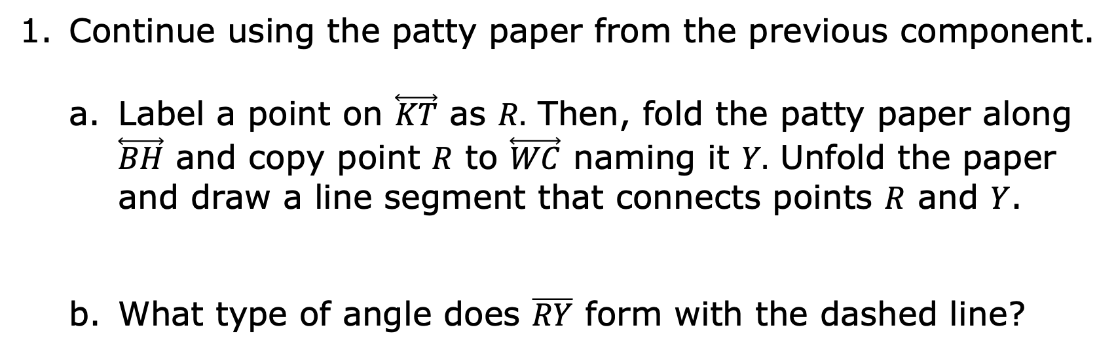
1.1.3 Collaboration: Definitions
Continue using the patty paper from the previous component.
Label a point on $\overset{⃡}{KT}$ as $R.$ Then, fold the patty paper along $\overset{⃡}{BH}$ and copy point $R$ to $\overset{⃡}{WC}$ naming it $Y.$ Unfold the paper and draw a line segment that connects points $R$ and $Y$.
What type of angle does $\overline{RY}$ form with the dashed line?
A right angle is an angle measuring exactly $90°$.
volume 1, pg. 7

Slide 19

Use a ruler to measure the distance between point $R$ and the dashed line, and between point $Y$ and the dashed line. Write the measurements, with units, on the diagram.
Discuss with your partner: when you reflect an object across a line, will corresponding points be the same distance from the line of reflection? Summarize your discussion.
volume 1, pg. 7

Slide 20
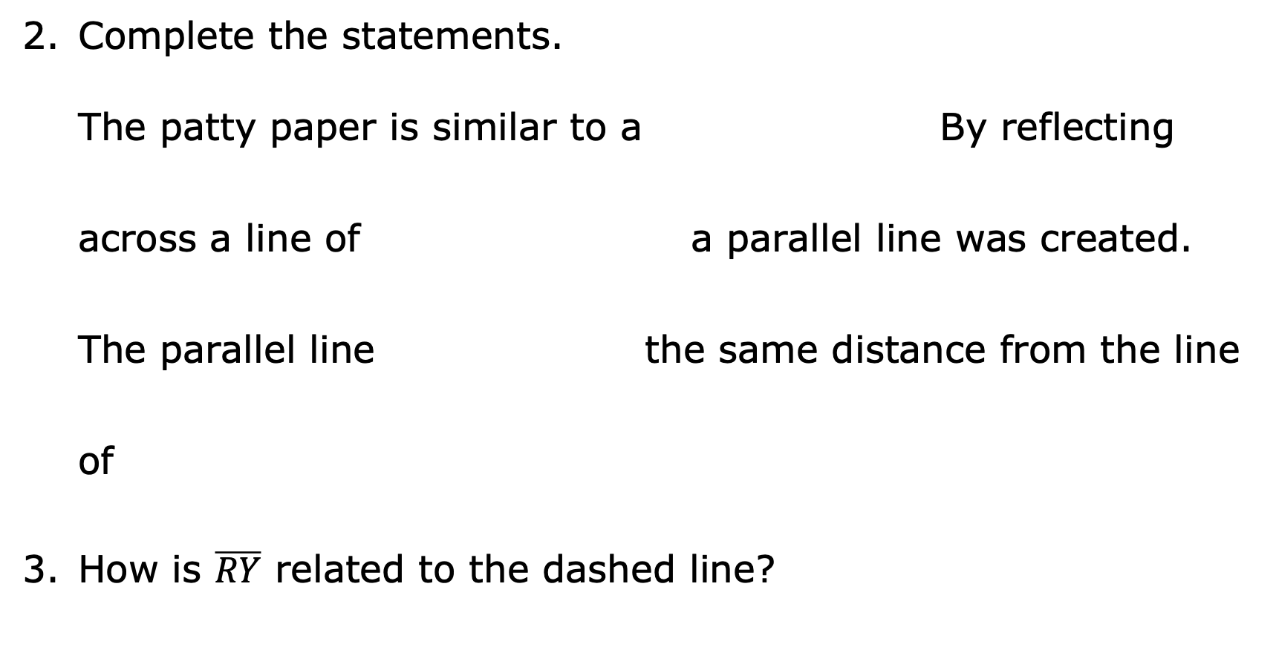
Complete the statements.
The patty paper is similar to a By reflecting across a line of a parallel line was created.
The parallel line the same distance from the line of
How is $\overline{RY}$ related to the dashed line?
plane.
reflection.
reflection,
rotation,
is
is not
reflection.
rotation.
volume 1, pg. 7

Slide 21
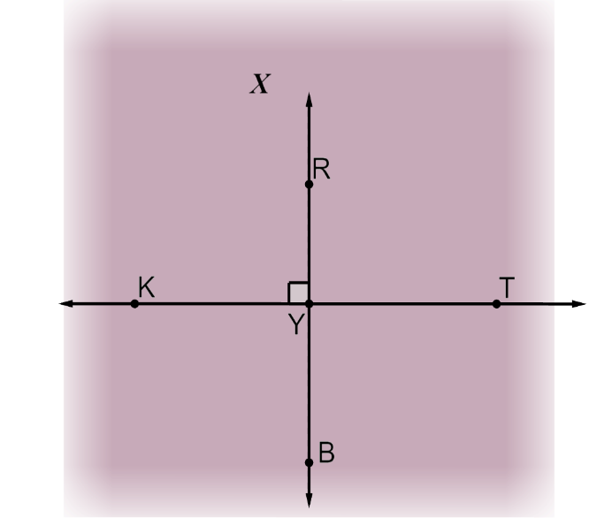
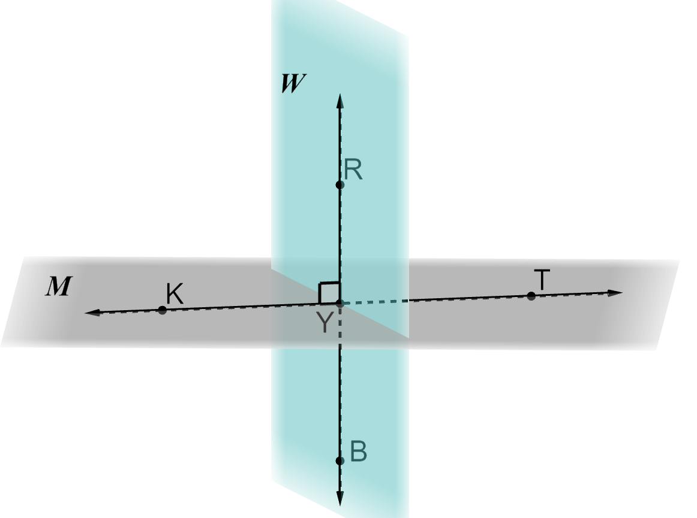
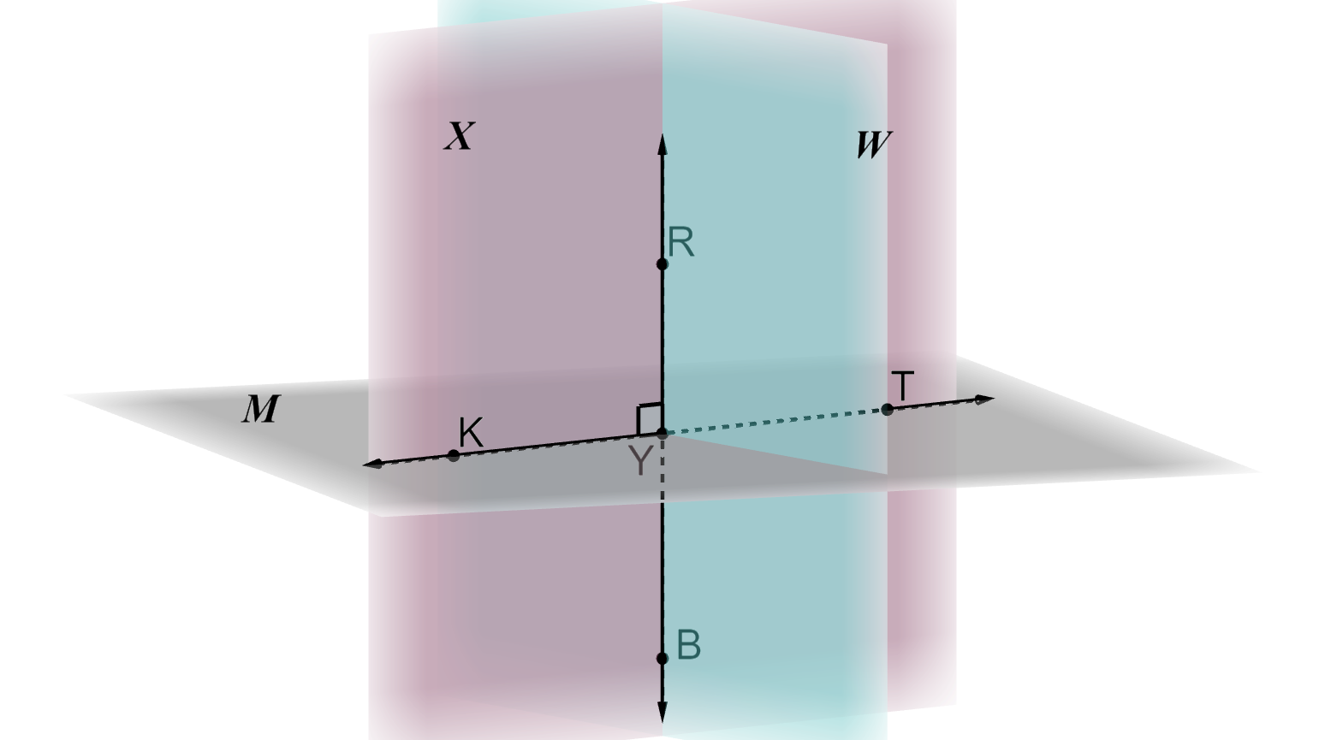
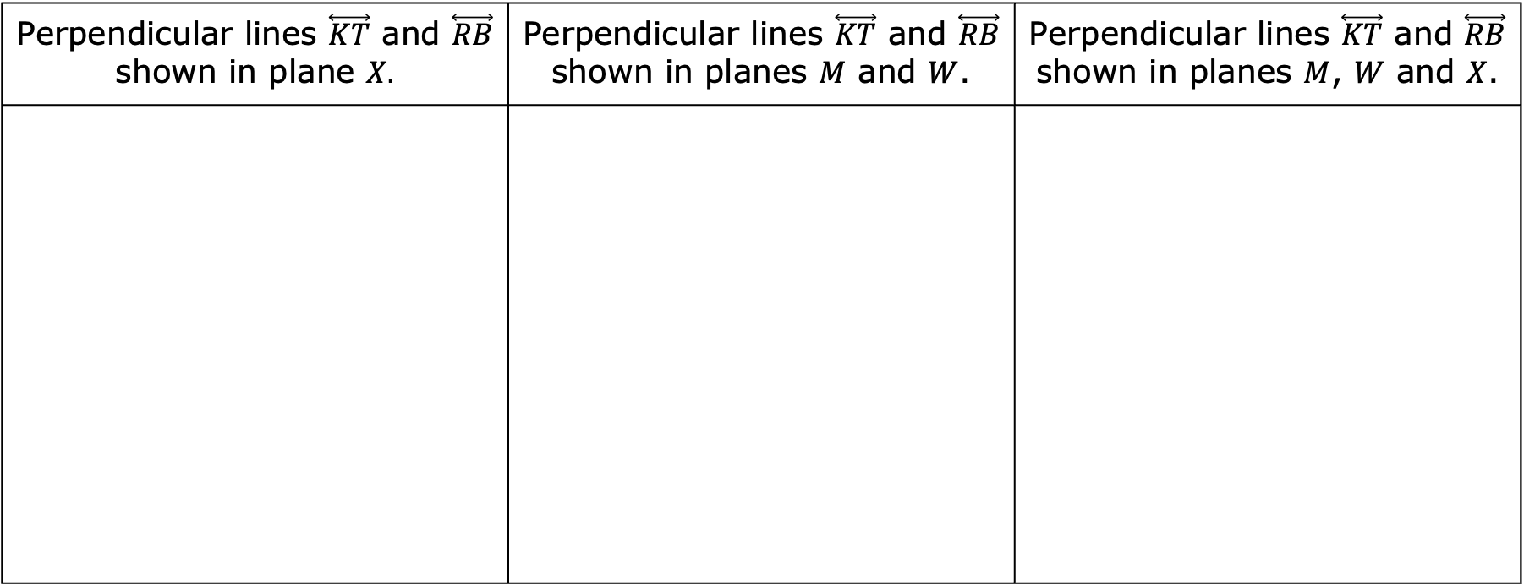
Perpendicular lines are lines that intersect at right angles.
The table shows multiple examples of perpendicular lines.
Perpendicular lines $\overset{⃡}{KT}$ and $\overset{⃡}{RB}$ shown in plane $X.$ | Perpendicular lines $\overset{⃡}{KT}$ and $\overset{⃡}{RB}$ shown in planes $M$ and $W$. | Perpendicular lines $\overset{⃡}{KT}$ and $\overset{⃡}{RB}$ shown in planes $M$, $W$ and $X$.
If two lines are perpendicular, then any two adjacent angles formed are ____________.
volume 1, pg. 8

Slide 22

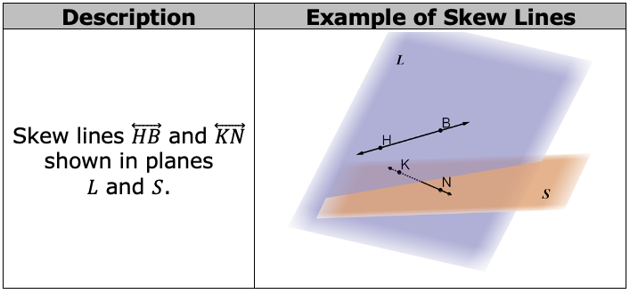
Skew lines are lines that do not intersect and are not parallel.
The table shows an example of skew lines.
volume 1, pg. 8

Slide 23

Wrap-Up
volume 1, pg. 9

Slide 24
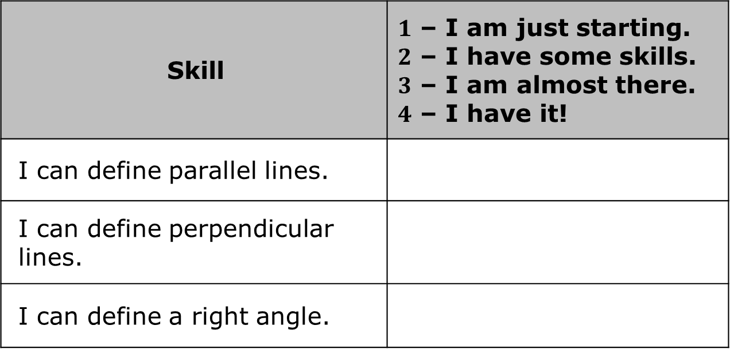
1.1.4 Wrap-Up: Reflection
Rate yourself based on what you understood in today’s lesson.
Skill | $1$ – I am just starting. $2$ – I have some skills. $3$ – I am almost there. $4$ – I have it!
I can define parallel lines.
I can define perpendicular lines.
I can define a right angle.
volume 1, pg. 9

Slide 25
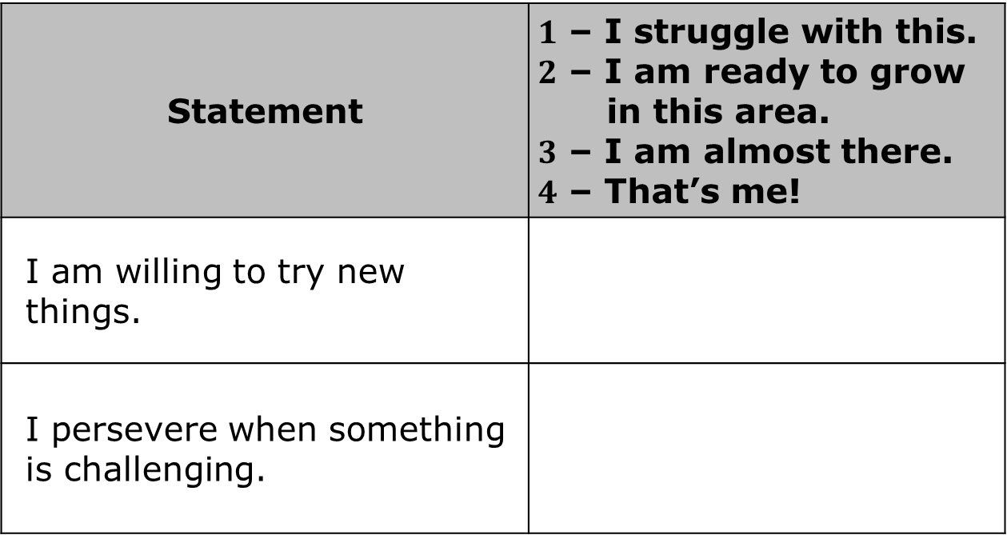
Rate yourself based on how you feel about the following statements.
Statement | $1$ – I struggle with this. $2$ – I am ready to grow in this area. $3$ – I am almost there. $4$ – That’s me!
I am willing to try new things.
I persevere when something is challenging.
volume 1, pg. 9

